Slide 1
Re-Introduction To
Web Based Application

Slide 2
Web-based application
Run on WWW – http protocol
Using WWW technology & software
Request and response protocol

Slide 3
Request & Response
Web browsers (request)
  Programs running on client computers
  Request for documents using URL
  eg. Chrome, Firefox
Web servers (response)
  Programs that provide documents to browsers
  eg. Apache

Slide 4
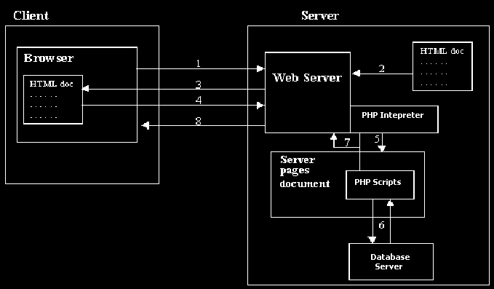
Web Architechture
How the Web works for static contents (basic architecture)
CGI scripts

Slide 5
Web Application Architecture
End-user request for document in browser
Web server find/retrieve the document
Web server response by sending the requested document to the end-user browser

Slide 6
Example tech./framework
Server producing HTML
  Conventional CGI – Perl, C, C++, Python, VB
  Java Servlet
  Server pages – ASP, PHP, JSP
Client side script
  JavaScript

Slide 7
5-Business process
Servlet
6-DB access
HTML(JSP), CSS,
& Javascript
SQL
Notes:
All of our discussions today will be presented in the C computer language.
For C, there are a few required elements which an application must do:
Header files describe all of the function calls, their parameters and defined constant values to the compiler. OpenGL has header files for GL (the core library), GLU (the utility library), and GLUT (freeware windowing toolkit).
Note: glut.h includes gl.h and glu.h. On Microsoft Windows, including only glut.h is recommended to avoid warnings about redefining Windows macros.
Libraries are the operating system dependent implementation of OpenGL on the system you’re using. Each operating system has its own set of libraries. For Unix systems, the OpenGL library is commonly named libGL.so and for Microsoft Windows, it’s named opengl32.lib.
Finally, enumerated types are definitions for the basic types (i.e. float, double, int, etc.) which your program uses to store variables. To simplify platform independence for OpenGL programs, a complete set of enumerated types are defined. Use them to simplify transferring your programs to other operating systems.

Slide 8
What we will learn
Server generated HTML
  Servlet
  JSP
Browser CSS – responsive
  Bootstrap
Backend Database
  Mysql/mariadb

